Slide 1
Tompkins Robotics Team 5427
Safety Presentation

Slide 2
Tompkins Robotics Team 5427
BASIC SAFETY TRAINING
5427 Basic Safety Training Rev. A

Slide 3
COVID-19 Symptoms
Cough
Shortness of breath
Chills
Repeated shaking with chills
Muscle pain
Headache
Sore throat
Loss of taste or smell
Diarrhea
Feeling feverish or a measured Temperature greater than or equal to 100.0 degrees Fahrenheit
Known contact with a person who is lab confirmed to have COVID-19

Slide 4
After a Positive COVID-19
Anyone experiencing symptoms of COVID-19 must stay home and should contact their medical provider. The following criteria must be met in order to return to campus:
72 hours have passed since recovery of symptoms without the use of fever-reducing medications
AND, has improvement of symptoms
AND, at least 5 days have passed since symptoms first appeared

Slide 5
Steel Talons Safety Principles
YOU are responsible for keeping the Steel Talons team safe
ANYONE can STOP ANYONE doing ANYTHING that is UNSAFE!
Anyone not wearing proper PPE – STOP THEM
Anyone using any tool in an unsafe manner – STOP THEM
Anyone who is acting unsafely – STOP THEM
If YOU see an unsafe situation – FIX THE SITUATION

Slide 6
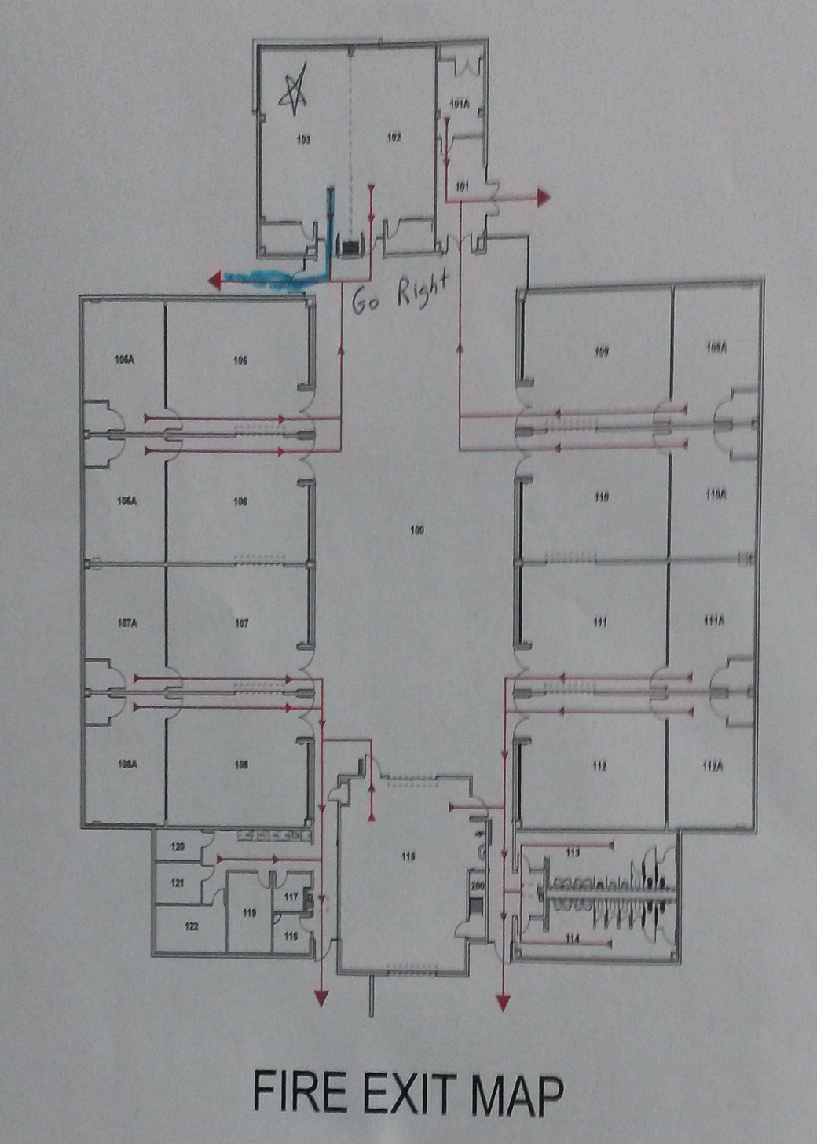
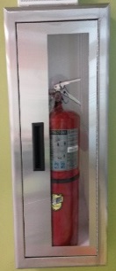
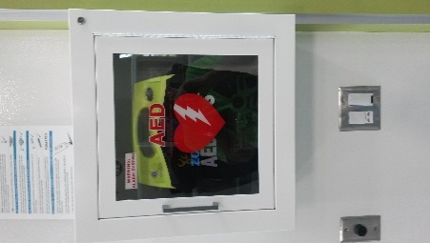
RSC Safety Building Emergency & Equipment
C
A = Emergency Exits
A
A
C
D
F
F
G
B = Extinguishers
G
B
B
C = Fire Alarm Pull
B
B
G
G
F
F
F
F
D = AED
G
B
B
G
G
B
B
G
E = Safety Shower / Eyewash
F
B
F
F
B
E
B
C
C
F = First Aid Kit
A
A
G = Goggle Sanitizer
Solenoid Valve

Slide 7
Steel Talons & RSC Safety Rules
Adult Supervision
KISD employee must be present in building
Two mentors required on site, one may be the KISD employee
No one-on-one student/adult work
No unsupervised student work
Building secured by KISD employee after work session
Sign in and out at the front door to our bay
RSC requires students to swipe their badges when entering building and the bay
Parents are expected to pick up students promptly after sessions
Be courteous to our neighbors in the RSC
No open flames in the building
Solenoid Valve

Slide 8
Steel Talons & RSC Safety Rules (continued)
Safety glasses
Required in work bays, central shop, and within 5 feet of field when in use
Must meet OSHA Z-87
Side shields required (or compliant wrap-around glasses or goggles)
Normal glasses with side shields do NOT satisfy this requirement
Glasses must be clear or only lightly tinted – we must easily see your eyes
Shoe requirements
Substantial, closed-toed shoes shall be worn in all work areas
Required within 5 feet of the central field area of the RSC
Flip-flops, sandals, flats, “Crocs”, and other footwear that has open holes are not permitted
Sole of shoe must resist puncture
Other personal protective equipment (PPE)
Specific PPE required in areas defined by KISD and building administration
Our team has specific PPE for each tool posted near each tool station
Wear appropriate gloves when handling sharp materials (leather or cloth) or handling chemicals (rubber or plastic) – we have more hand injuries than anything else
Use ear protection as needed – see the tool station requirements
Solenoid Valve

Slide 9
Steel Talons & RSC Safety Rules (continued)
Loose Clothing, Jewelry, Hair, Hoodies, etc.
Shall be kept out of the way when working with power tools
Do not wear rings when working with materials
Do not wear long-sleeves or gloves when working with potentially entangling tools (e.g. mill, drill press, belt sander)
Tie back long hair; remove jewelry; roll up long sleeves; take off hoodies
Training Requirements
Proper training in safe use required to operate a power tool. Includes everyone working at the RSC (mentors and students)
Each team has people trained to teach others on their team the required procedures
We maintain records to demonstrate this requirement has been met
Team Safety Programs
Within our bay, we have more strict safety requirements than the RSC
Use proper tools, in good condition, for each job
Contact mentors immediately if any problems arise or if you don’t know how to do something
Solenoid Valve

Slide 10
Steel Talons & RSC Safety Rules (continued)
Chemicals & Paint Usage
No use of volatile or vapor emitting chemicals in the building
No spray painting in the building – OK out back with adult supervision
Proper PPE required when handling chemicals – e.g. gloves
Materials must be used in accordance with the manufacturers instructions
We have MSDSs (or SDSs) available for the chemicals we use in our area
In the event of a spill, notify KISD representative and mentor
Behavior
No horseplay or rowdy behavior on the premises
Food and Drinks
No food or drinks (except water) in the bays
Food is allowed around the central bay (not on the carpet) and outside the building (patios)
Wash hands thoroughly with soap and water before handling food or drink
Solenoid Valve

Slide 11
Steel Talons & RSC Safety Rules (continued)
Daily Housekeeping Requirements
Keep areas clean and uncluttered
Keep emergency exits clear
Keep carpeted area clear of debris and cuttings, no drilling or cutting on carpet
Clean up begins 15 minutes before the end of a session
Clean area before you leave
Trash and recyclables are to be cleaned up and disposed of in the proper locations
Floor shall be swept and vacuumed as needed
Tools, surplus raw materials, and other items shall be put away when finished with them
Clean up the area outside if it has been used for painting or other activities
All power should be turned off at the end of the day
Solenoid Valve

Slide 12
Steel Talons & RSC Safety Rules (continued)
Incident Reporting Requirements
Report any incident resulting in injury, fire, or damage to people, building, or equipment immediately to a KISD representative and a mentor. This includes minor first aid incidents such as a band aid
Report near-misses which could have resulted in injury to our safety team
To report an injury or near-miss to our team, use the form at the sign-in table
To report an injury to the RSC, go to the RSC administrator’s office
Solenoid Valve

Slide 13
Why Safety?
If you have 10 fingers and 10 toes it is hard to learn how to live your life with less!
Your parents want you to take care of them when they get older!
It is always fun until someone loses an eye!
We are Tompkins Robotics, not Tompkins Do Crazy Stuff Until Someone Gets Hurt!

Slide 14
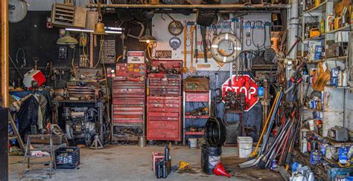
Safety Ground Rules
Safety is YOUR job. Never assume someone else is doing something safely!
See something unsafe? Tell people. If you see ANYONE doing something unsafe STOP THEM!
Cleanliness and Organization are foundational keys to safety.

Slide 15
Safety Ground Rules
Plan your work before you do your work
Discuss what you will be doing with your team mates.
What are the risks that you may encounter? How can you mitigate those risks? Planning your work allows you to prepare to stay safe.

Slide 16
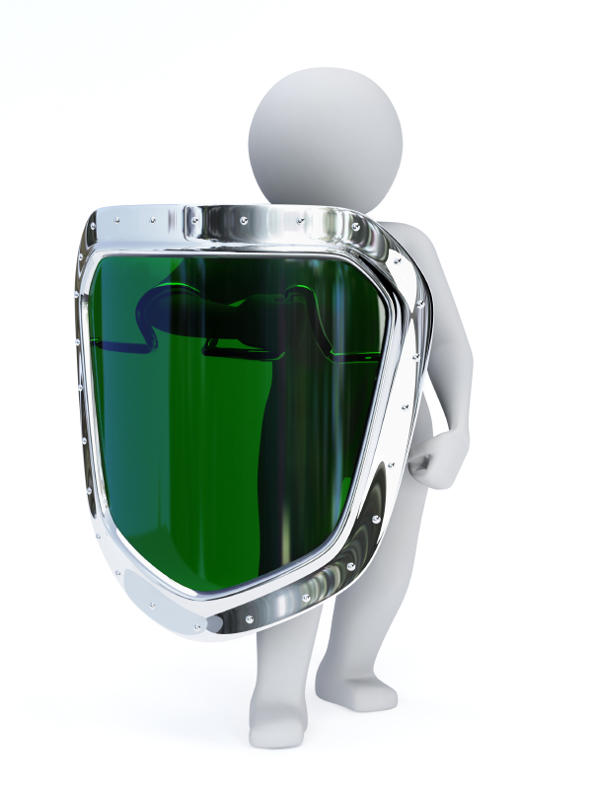
Protecting Yourself
Be aware of EVERYTHING around you.
Always wear your PPE.
Personal
Protective
Equipment
PPE is a fashion statement. It states that you want to stay fashionably alive and unhurt!

Slide 17
PPE Eye Protection
Safety Glasses – Protecting Your Eyes
Must be worn at all times in all areas around the robot.
Must be ANSI approved. Look on the side of the glasses for the ANSI z87 mark.
Must have side shields, or wrap around protection.
Must be worn over prescription glasses, if your glasses do not have side shields or are not ANSI approved.
Splash goggles or a face shield must be worn OVER safety glasses if handling liquid chemicals.

Slide 18
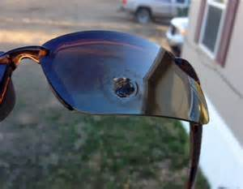
PPE Eye Protection

Slide 19
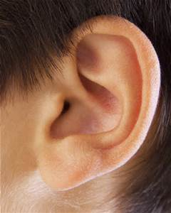
PPE Hearing Protection
Safe hearing range is 70 dB over
8 hrs.
Every 3dB increase doubles the
sound energy or impact
A whisper, 30 dB, is 1,000 times
louder than the softest sound you
can hear.

Slide 20
PPE Hearing Protection
Hearing loss is permanent
Can occur gradually over time, due to acute and chronic noise.
Proper protective equipment
Ear Plugs – FOLLOW DIRECTIONS ON USE
Ear Muffs
Must be worn when power tools are in use or if Rolling Stones are performing a concert in the work area.

Slide 21
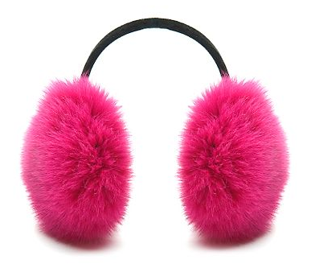
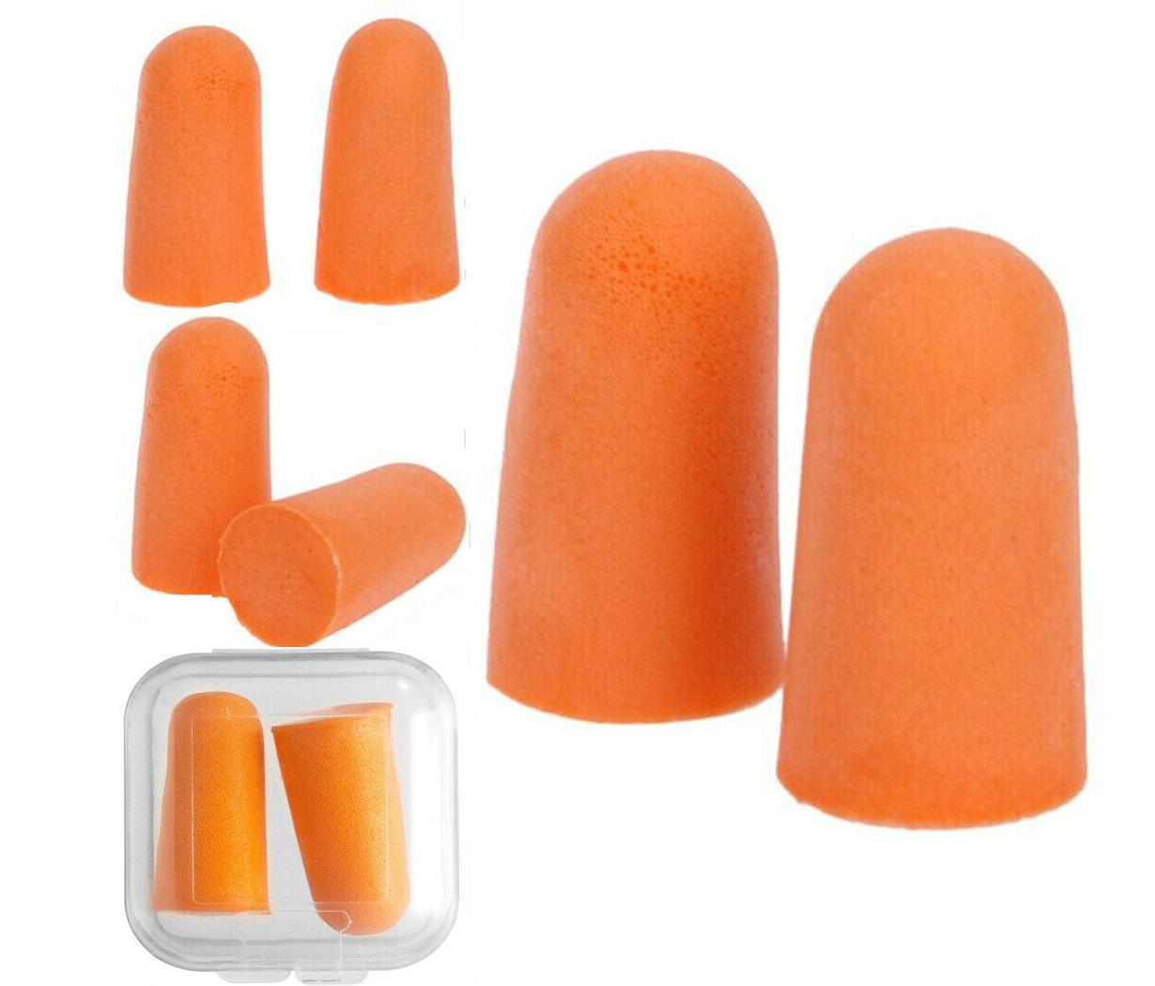
PPE Hearing Protection
ACCEPTABLE
These are for work!
UNACCEPTABLE
These are for snuggling up when
it’s cold outside!

Slide 22
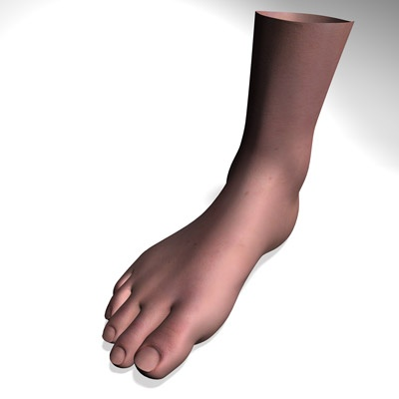
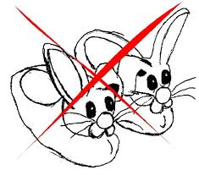
PPE Foot Protection
NO
Bare Feet
Open toed shoes
Sandals
Flip Flops
Bunny slippers
Slippers
Shoes should be sturdy
Steel toed shoes may be required when lifting the robot or other heavy objects.

Slide 23
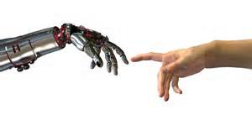
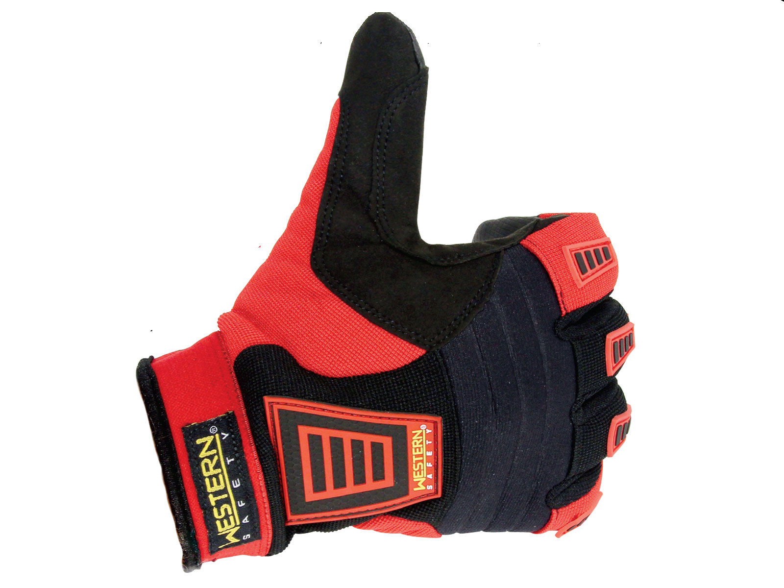
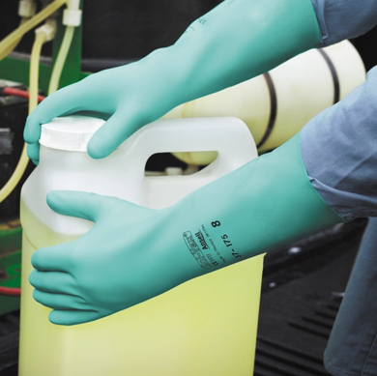
PPE Hand Protection
Safety Gloves should be worn when:
When cutting or working with sharp objects
Working with soldering gun
Handling metal and wood
Lifting
Chemically resistant gloves must be worn when handling liquids or leaking batteries
Hanging around – just in case
DO NOT WEAR GLOVES WHEN OPERSSTING ROTATING EQUIPMENT – THAT IS A SNAG HAZARD

Slide 24
PPE Hand Protection
Safety Gloves prevent:
Cuts
Splinters
Pinches – other than the ones from your relatives
Scrapes
Burns
Chemical Burns
Nail polish damage

Slide 25
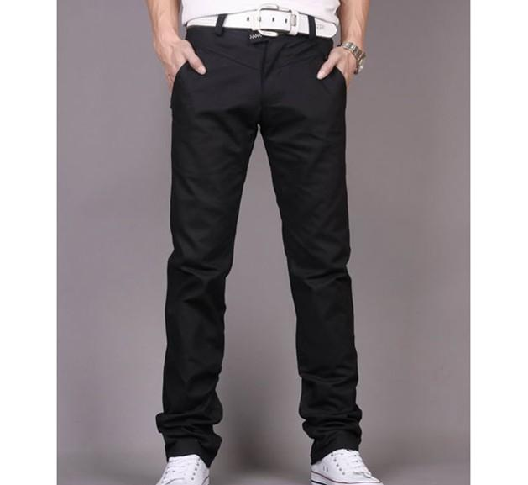
PPE - General
Long pants are recommended to prevent scrapes and cuts.
No loose clothes or neck ties. These can get caught in equipment.
Long hair is to be pulled back.
No long or dangling jewelry.
No Philadelphia Eagles clothing.

Slide 26
Power Tools
Power Tools are great work savers:
They reduce strain and effort
Help reduce the time needed to perform a task
Are easy to learn and operate
Can allow work that might not be done without them.
Give more precision than most hand tools
THEY WILL HURT, MAIM, OR KILL YOU!!

Slide 27
Power Tools
Do not use power tools unless you have been trained and authorized
Treat them as if they were energized, always
Inspect each tool before using. You are responsible for your own tool inspections
Turn off and unplug or remove battery when not in use
“Test Fire” after turning off to de-energize
Never remove guards – ever
Alert those around you that you are using a power tool
Treat each tool with care

Slide 28
Power Tools
Always return to their proper place when done.
Always secure your work piece
Clamp it
Bolt it
Insure that it cannot move
USE PROPER PPE FOR EACH PIECE OF EQUIPMENT.

Slide 29
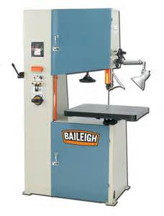
Power Tools - Cutting
TABLE SAW
MITER SAW
BAND SAW
SAWZ ALL
CIRCULAR SAW
JIG SAW

Slide 30
Power ToOls - Cutting
Injury Risks
Cutting
Flying debris / Inhaled debris
Entangling and cutting
Kick back or throwing a work piece.
Always assume it is energized!
Never touch the blade unless the saw is turned off, unplugged, and you have “test fired” the saw

Slide 31
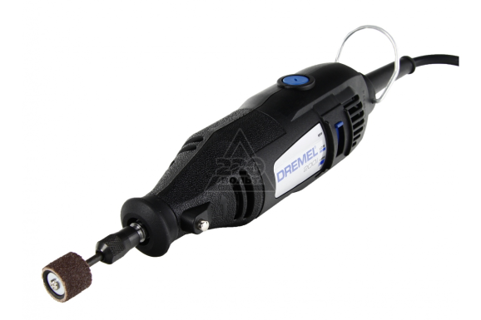
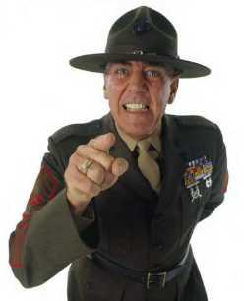
Power Tools - Drilling
Drill Press
Power Drill
Dremel Drill
Drill Sergeant

Slide 32
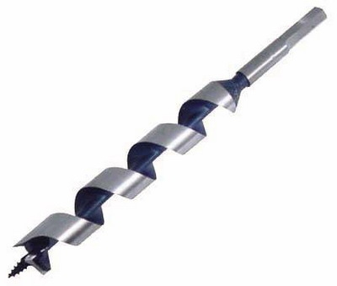
Power Tools - Drilling
Injury Risks
Cutting – the sides are sharp
Debris
Entangling on loose fitting clothes
Work piece kick back or twirling
Drill bit breaking and flying

Slide 33
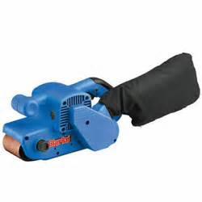
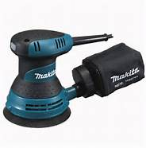
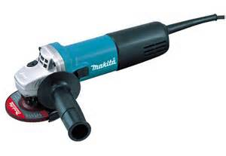
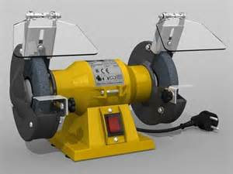
Power Tools - Abrasives
ORBITAL SANDER
BELT SANDER
BELT SANDER
GRINDING OR CUT OFF WHEEL

Slide 34
Power Tools - Abrasives
Injury Risks
Scrapes
Debris – Inhaled Dust – Dust Mask Mandatory.
Entanglement
Grinding wheels and cut off wheels
The name “cut off” says it all. It can cut pieces of you off!

Slide 35
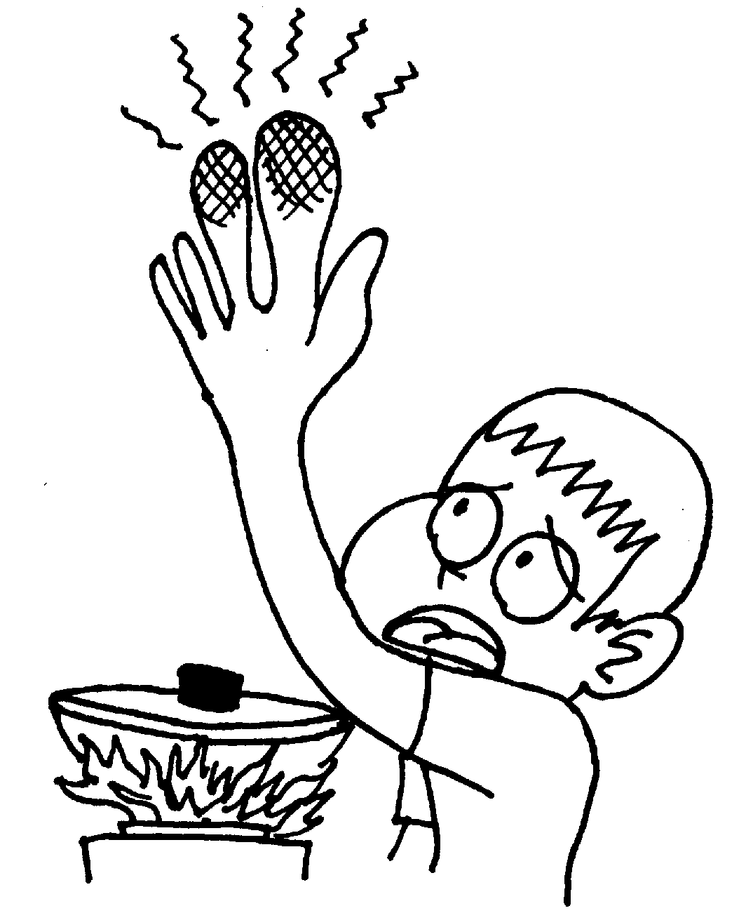
General Risks
Soldering – Burns
Work Area – Slip, trip, and falls.
Clean up
No horse play
These are tools not toys
Hand tools
Cuts
Scrapes
Pinches
Whacks

Slide 36
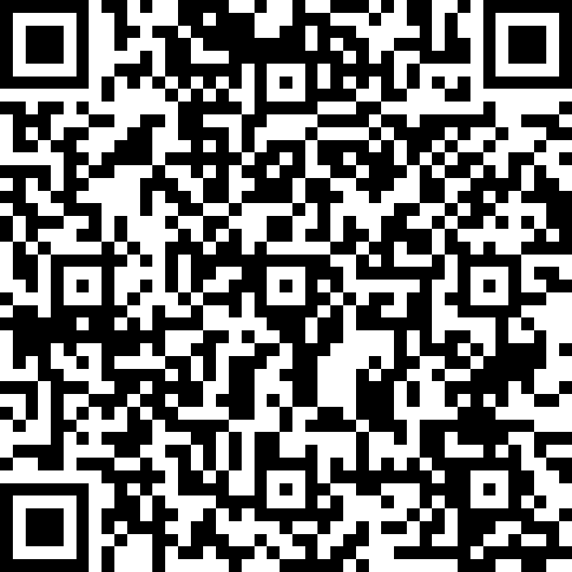
Take the test!!

Slide 37
Be Safe!
And we’ll have a lot of fun!

